Slide 1
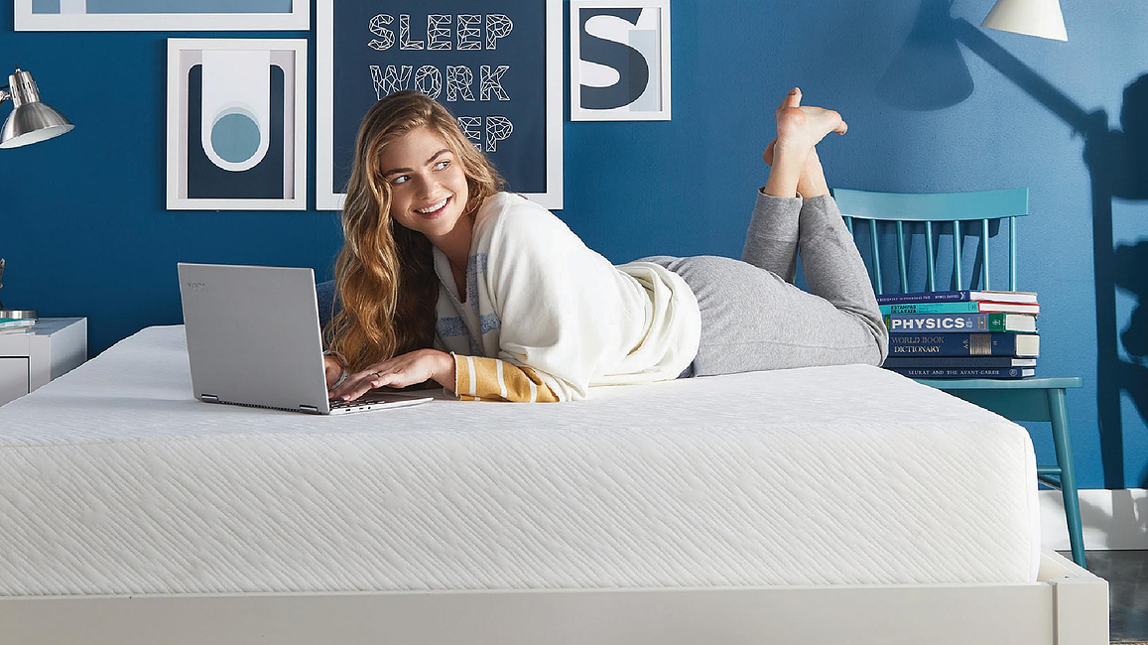
Sleep Cool Acquisition Analysis
Yuying Chen, Nikhil Cherukuri, Felix Cruz-Montanez, Jessie Lam, Ting-Chun Lin, Colin Petitt

Slide 2
Executive Summary
Recommend acquisition of Sleep Cool based on following factors
Effectiveness of Sleep Cool technology
Continued growth in online mattresses market
Best Rest brand equity among customers and non-customer

Slide 3


Sleep Cool demonstrates lower temperatures and better sleep
Average Mattress Temperature Before Waking (°C)
Average Deep Sleep and Awake Time (Mins)
Cooler
-67
-64
+14
+13
Data source: Sleep Cool Study
The test result is based on the study of 147 sleep testers’ response. Six sets of T-test (paired two sample for means) were respectively conducted to examine whether Sleep Cool mattress is cooler, and promotes better sleep than competitors. Based on the test result, at the 0.05 significance level, we can conclude that: a) Sleep Cool reduces the mattress temperature before waking; b) reduce awake time; c) increase the deep sleep time.
With 95% confidence level, for Sleep Cool mattress, we can conclude that the whole population mean of temperature before waking fall within the range [ 90.26, 90.4], deep sleep time in the range [ 250, 263], and awake time in the range [ 34.5, 40]

Slide 4



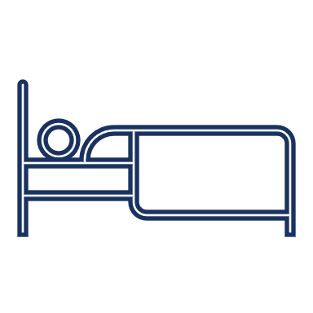
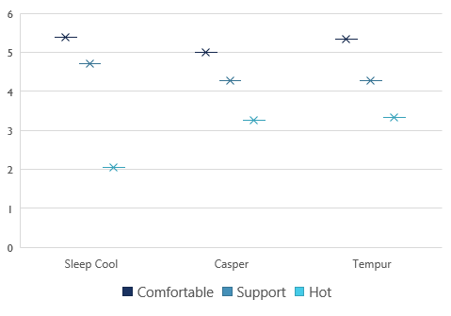
Sleep Cool VERSUS two leading competitors
Customer Response Score
76% favors comfortable
88% favors coolness
59% favors back support
Data source: Sleep Cool Study
The average response score is calculated based on 147 customer response. Response scale from 1 to 7 are respectively: strongly disagree, disagree, slightly disagree, neither agree or disagree, slightly agree, agree, strongly agree

Slide 5


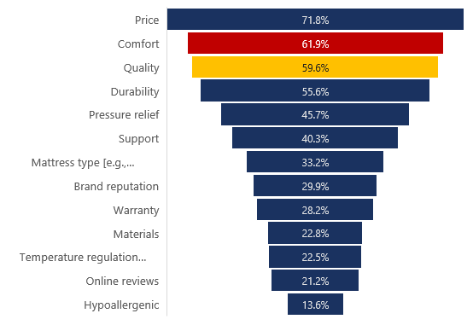
Customers Prefer mattresses to be comfortable, supportive and cool
Sleep Cool mattresses provide what customers desire
Mattress Purchase Factors
Comfortable
Back Support
Hot
Correlation Matrix for Customers Preference
 | Comfortable | Support | Hot | Like | Buy
Like | 0.63 | 0.46 | -0.48 | 1
Buy | 0.62 | 0.44 | -0.44 | 0.63 | 1
Data Source: Sleep Cool Study
The correlation metrics is calculated based on the 147 responders’ view of Sleep Cool mattress.
Data source: Mattress Industry Report
The result is based on response of 819 internet users aged 21+ who purchased a mattress in last five years.

Slide 6

Customers have positive views of best Rest
Best Rest have strong brand reputation in terms of product quality, brand trust and brand quality. This would promote the Sleep Cool mattress entering the DCM market.
Both owner and non-owner of Best Rest brand trust the product
Irrespective of the gender, people have positive opinions on the Best Rest brand

Slide 7
Customers have positive views of best Rest
Best Rest brand has strong customer view across age groups
Low-medium income groups are more favorable Best Result product quality.
Data Source: Best Rest Brand Study
Hypothesis testing was conducted to test whether Best Rest has customer review score than 5 ( slightly agree). P=0.000001 for Product quality, p=0.002 for Brand trust and p=0.00002 for Brand quality. The test results suggest that at 95% confidence level, we can conclude that Best Rest products are of high quality, and it is a trusted brand, and their overall brand quality is of high quality.

Slide 8

A Promising Future for Online Mattresses
Online retailers rank as the No.2 mattress purchase channel.
Over 50% of customers have positive attitudes towards purchasing mattress online.
Your Most Recent Mattress Purchase From (Past)
Customer Preference on Purchasing Mattress Online
Data source: Sleep Cool Study
Data source: Mattress Industry Report

Slide 9
Market Potential
Online Purchase Potential
Current Buyers + Potential Buyers
___________________________
Total Populations
Data Source: Best Rest Brand Study,
Statista https://www.statista.com/statistics/241488/population-of-the-us-by-sex-and-age/

Slide 10

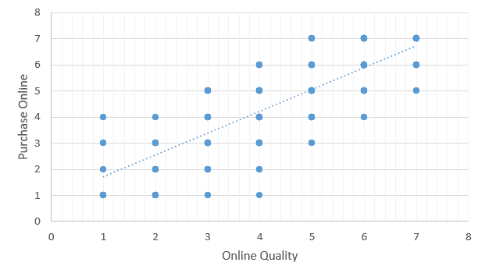
Online purchasing factors
Customer are more willing to buy online mattresses if they have a positive view of its quality.
Millennials display a higher interest in buying a mattress online, which is in favor of acquiring Sleep Cool.
Correlation between Purchase Online and Online Quality
Online Purchase Preference between Age Groups
Correlation Score: 0.82
Data Source: Mattress Industry Report

Slide 11
Conclusion
Best Rest should proceed with the acquisition of Sleep Cool based on several factors
Sleep Cool’s proprietary technology has been proven in testing
Average sleep/wake times are ahead of its competitors
Positive perception of comfort, temperature regulation and support
Best Rest’s reputation for providing quality products
22% of online mattress purchases by 18+ demographic meaning we expect continued increase in direct-to-consumer market

